Slide 1


Hot BOLTato Game
Create an exciting hot potato game with your BOLT robot! Toss BOLT back and forth with friends until it randomly kicks a player out. The last player standing wins!
Toss BOLT with friends
Pass the robot back and forth between players
Random elimination
After random tosses, BOLT kicks out one player
Play until one remains
Restart and continue until only one player is left

Slide 2
Variables
String Variables
In this lesson you will create
Store letters, numbers, and other characters
Number Variables
Hold numeric values like counts and calculations
tossNumber tracks tosses
expireNumber sets elimination point

Slide 3

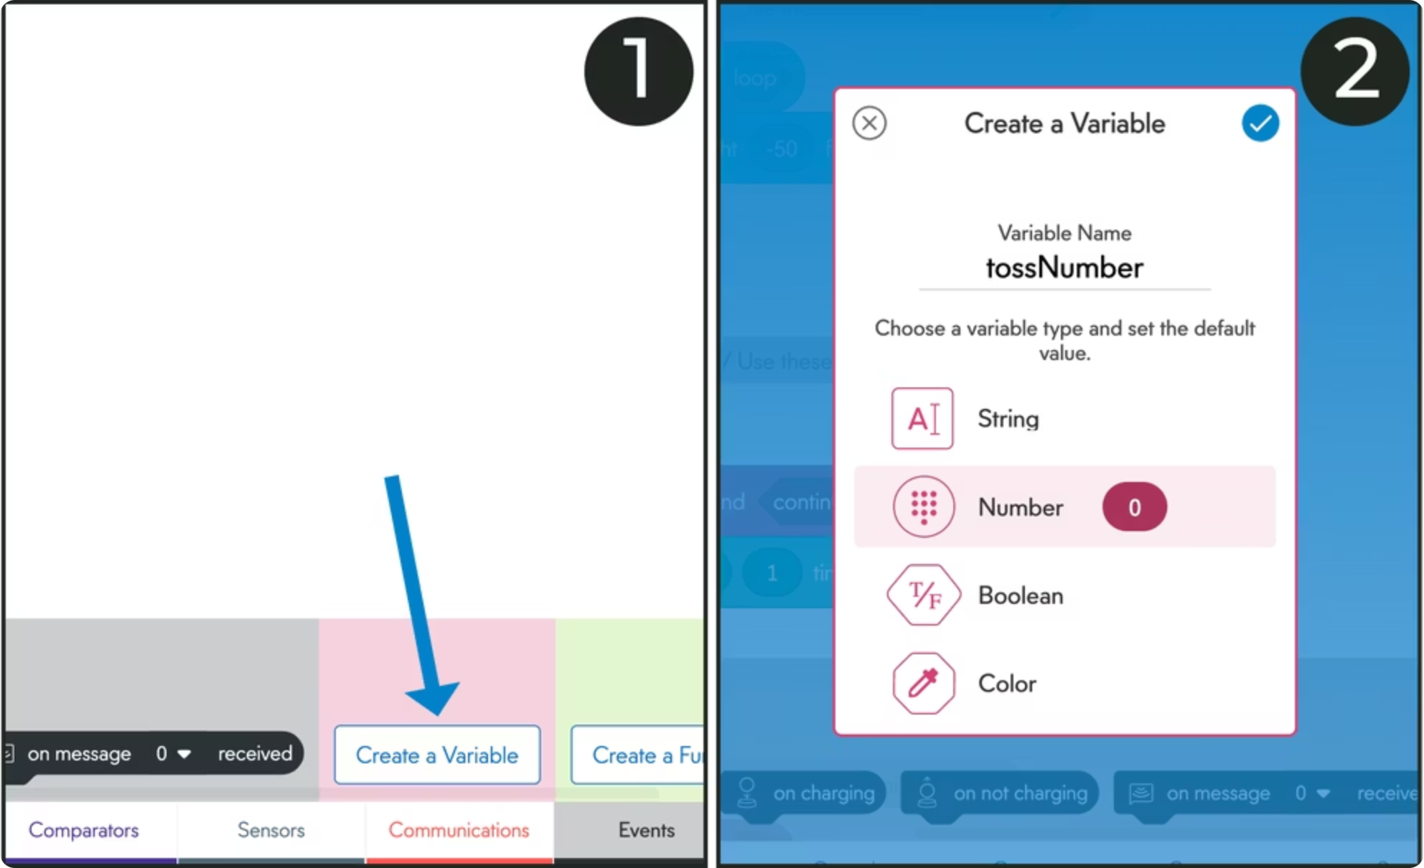
Creating Your Variables
Open the program and add the essential variables that will control your hot potato game.
01
Create tossNumber
Select "Create a variable", name it tossNumber, choose Number type, set initial value to 0
02
Create expireNumber
Repeat the process to create a second number variable called expireNumber

Slide 4
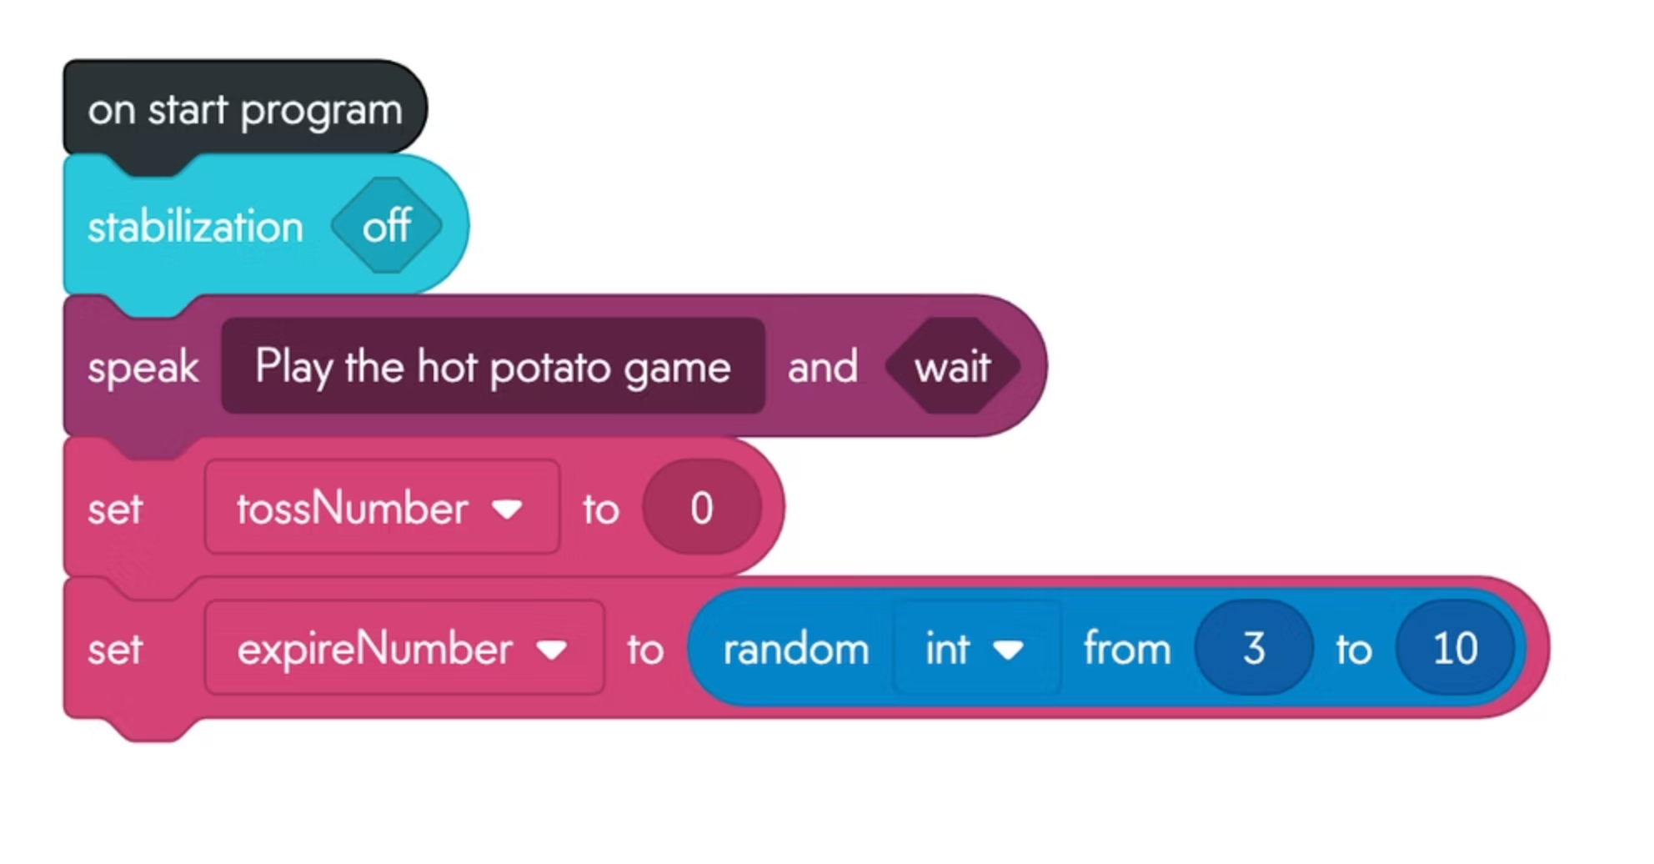
Setting Variable Values
tossNumber Setup
On start set to zero (0)
expireNumber Setup
Set to random number between 3-10.
Creates unpredictable elimination timing each game.

Slide 5


Creating the Game Logic
Build the core control structure using a loop until block that repeats until tossNumber equals expireNumber.
Discussion: What happens when you execute? Does the program ever leave the loop? Why not?

Slide 6
Add loop until block
Drag underneath the set variable block
Insert comparator
Place comparator block in hexagonal input
Connect variables
Set tossNumber === expireNumber condition

Slide 7
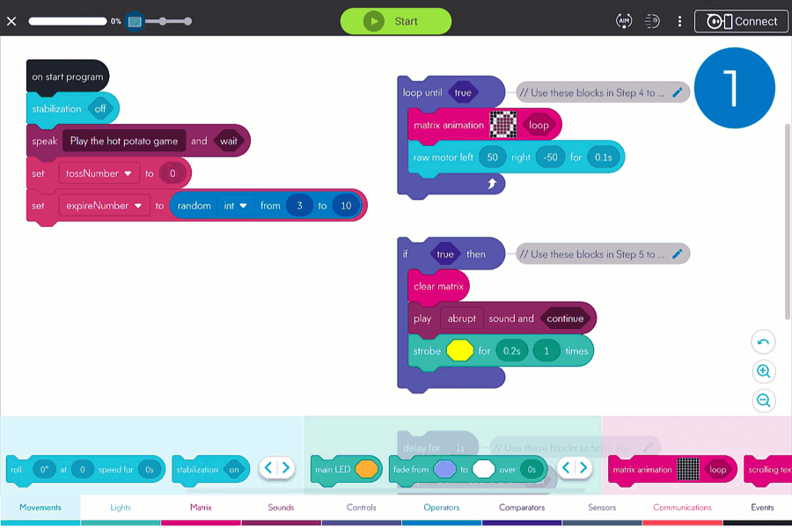

Slide 8
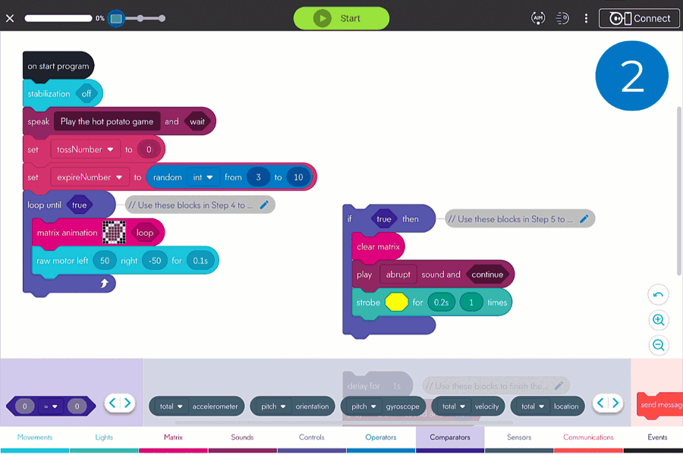

Slide 9
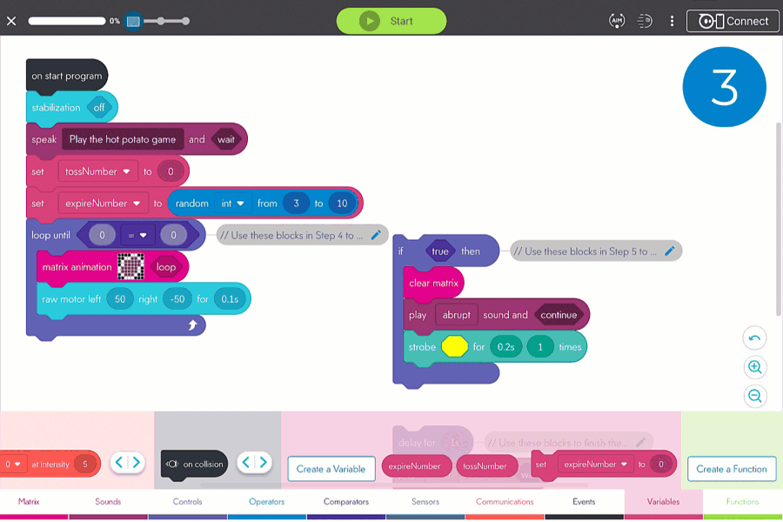

Slide 11


Challenge: Incrementing Variables
BOLT recognizes tosses but stays stuck in the loop. You must increment tossNumber by adding 1 each time BOLT is caught.
1
2
Add set variable block
Configure increment
Drag to bottom of if then block, set to define tossNumber
Set tossNumber to tossNumber + 1 to add 1 each catch
Educator Tip: When tossNumber equals expireNumber, BOLT exits the loop and continues the program.

Slide 12
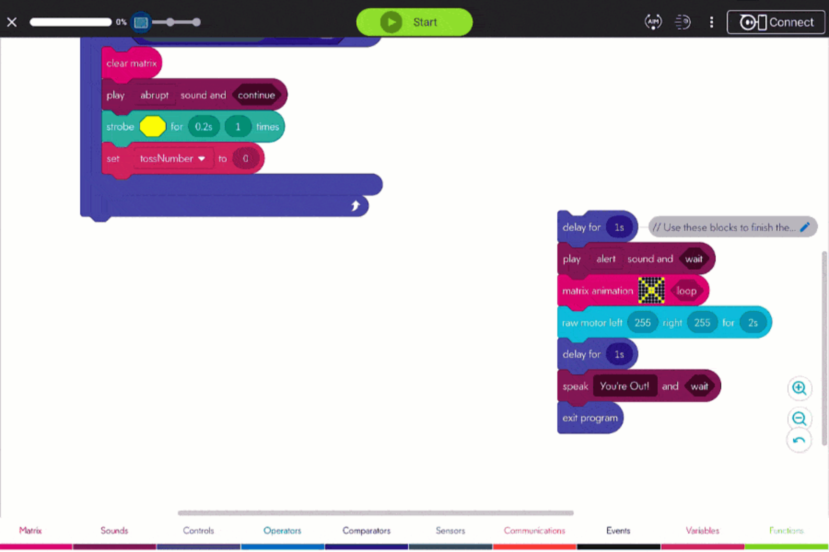
Play: Hot BOLTato
Your program is complete! Add the final blocks and gather friends for an exciting game of elimination.
1
2
3
4
5
Complete the program
Gather friends
Start and toss
Random elimination
Play until one remains
Get a group together for multiplayer fun
Begin the game and pass BOLT back and forth
BOLT kicks out one player after random tosses
Drag remaining blocks under the loop until block
Restart and continue until only one player is left

Slide 13

Congratulations!
You've completed BOLT Blocks 8 and mastered essential programming concepts! You're well on your way in your computer programming journey.
BOLT's Movement
Lights & Sounds
Sensors
Programming Events
Control and navigation
88 LED matrix programming
Input detection and response
Trigger-based actions
Control Blocks
Variables
Loops and conditionals
Data storage and manipulation
Grab a notebook and jot down your ideas for future projects. Share your best ideas with classmates - what games or projects would you like to build next?

